Slide 1

Analysing Research Trends and Collaborations in APOE Gene Therapy
Group Members:
Kai Vignau, Rui Chen, Sharwan Kumar, Rohan Chowdhury

Slide 2
Objective
Identify key active researchers in APOE gene therapy
Impact factor of Journals
Analyse publication trends and focus areas in APOE research
Trends and Themes in APOE Research: Keywords, Evolution, and Comparative Analysis
Map collaboration networks between researchers.
Highlight insights to guide strategic connections.

Slide 3
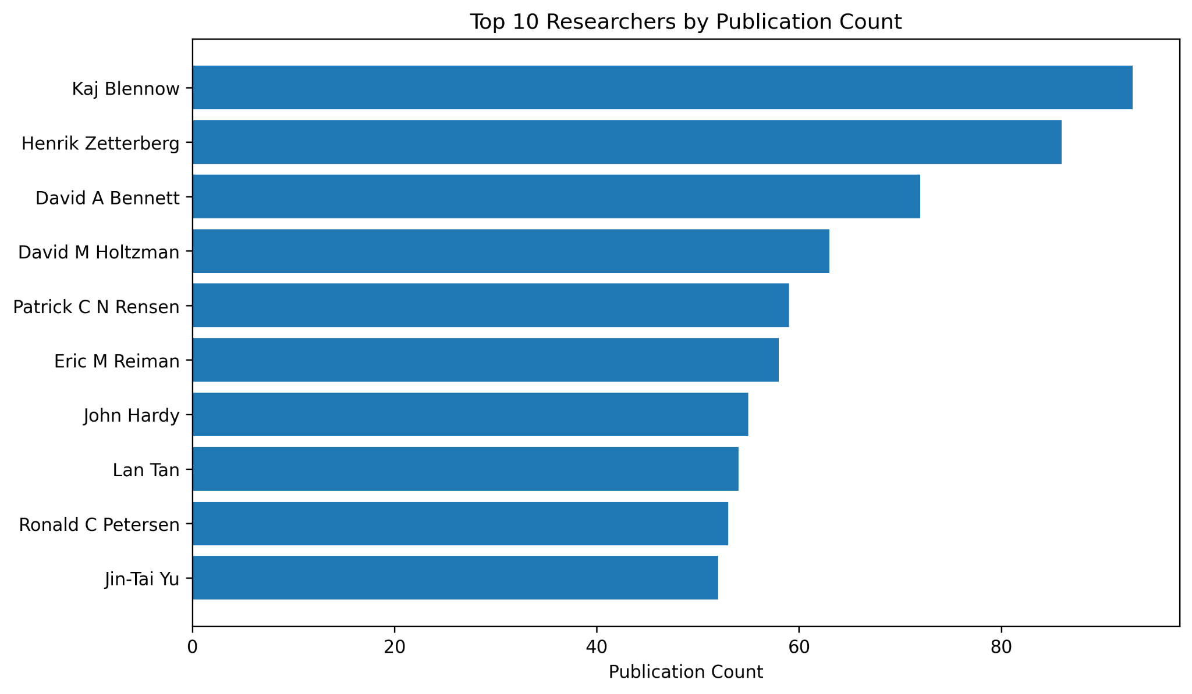
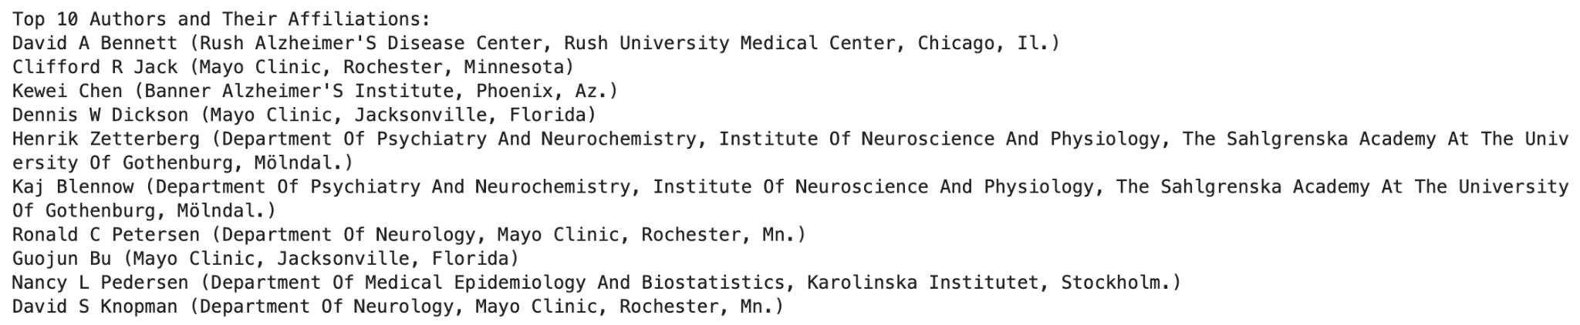
Top 10 Researchers by Publication Count
Figure displays the top 10 researchers of APOE gene therapy, by publication count
Can provide insight into who are the current leading experts in the field
Notes:
The purpose of this figure is to show which researchers have the most publications in the field of APOE gene therapy.

Slide 4
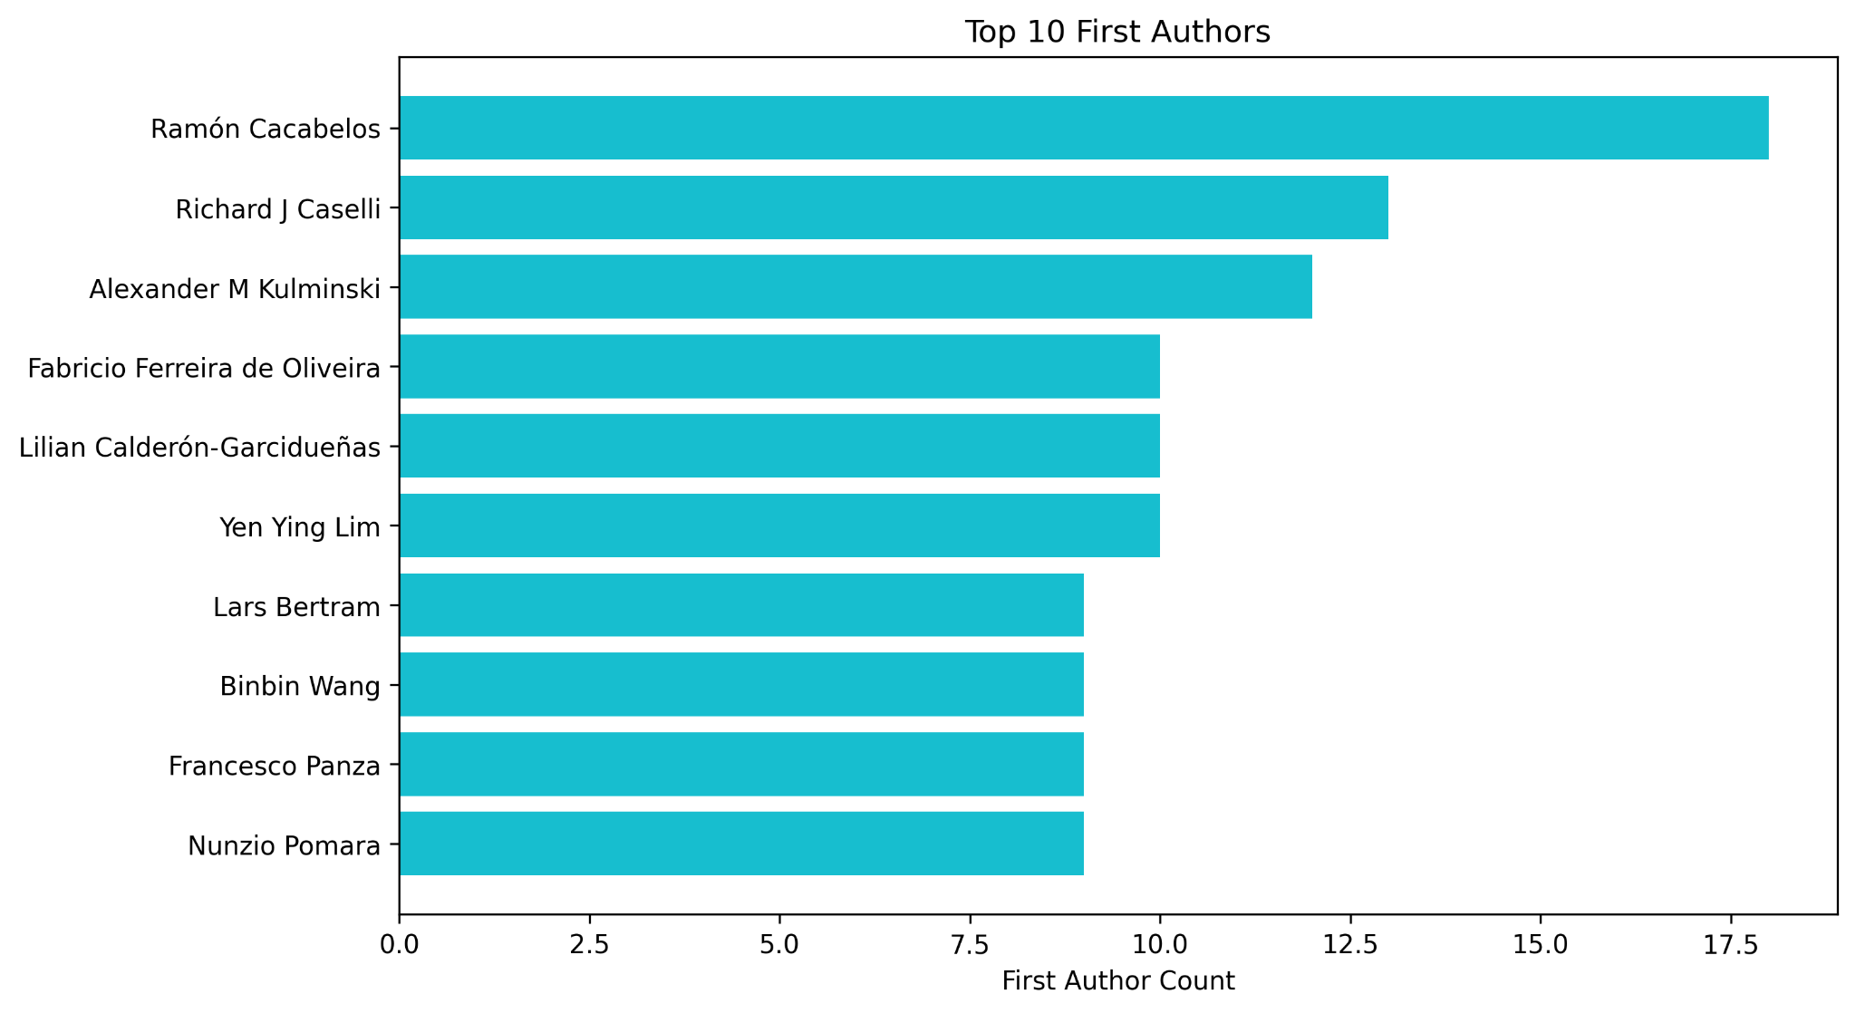
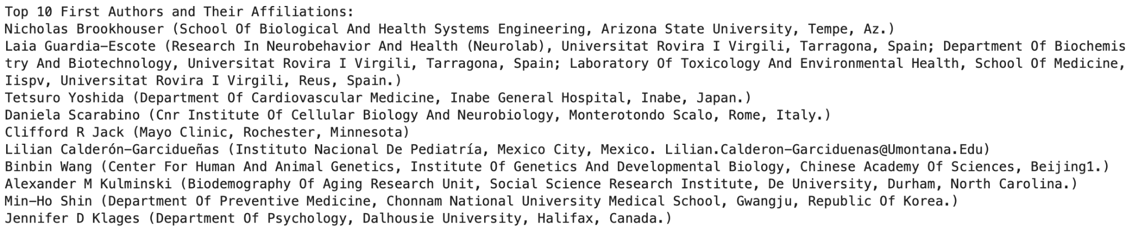
Top 10 First Authors
Figure displays the top 10 authors who appear first when credited
Can provide an alternative insight into who is prominent in APOE research
Notes:
The purpose of this figure is to show which authors are most often listen as the first author for any given publication. Generally, the first author listed is the person who has contributed the most, so this metric provides an indication of who are the most prominent contributors per paper/article.

Slide 5
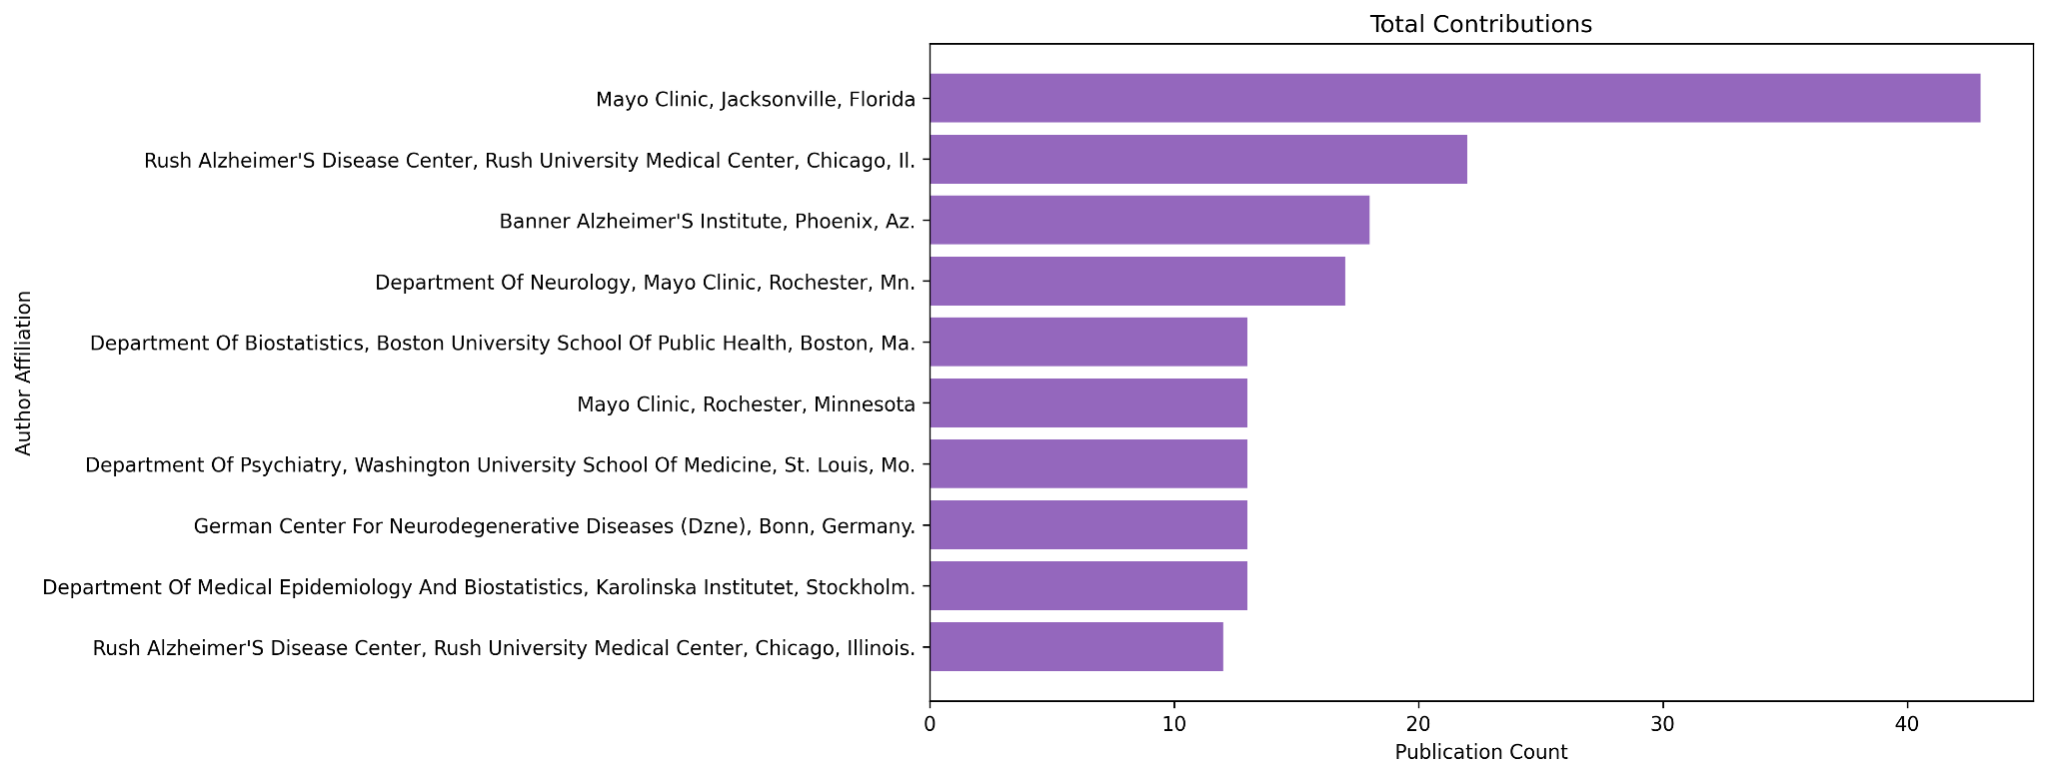
Contributions by Affiliations
Figure shows which institutions/organisations have published the most APOE related research
Notes:
This figure displays which organisations provide the most research on APOE gene therapy. Note that the author affiliations require further cleaning as some have been counted twice due to inconsistent inclusion of the area codes.

Slide 6
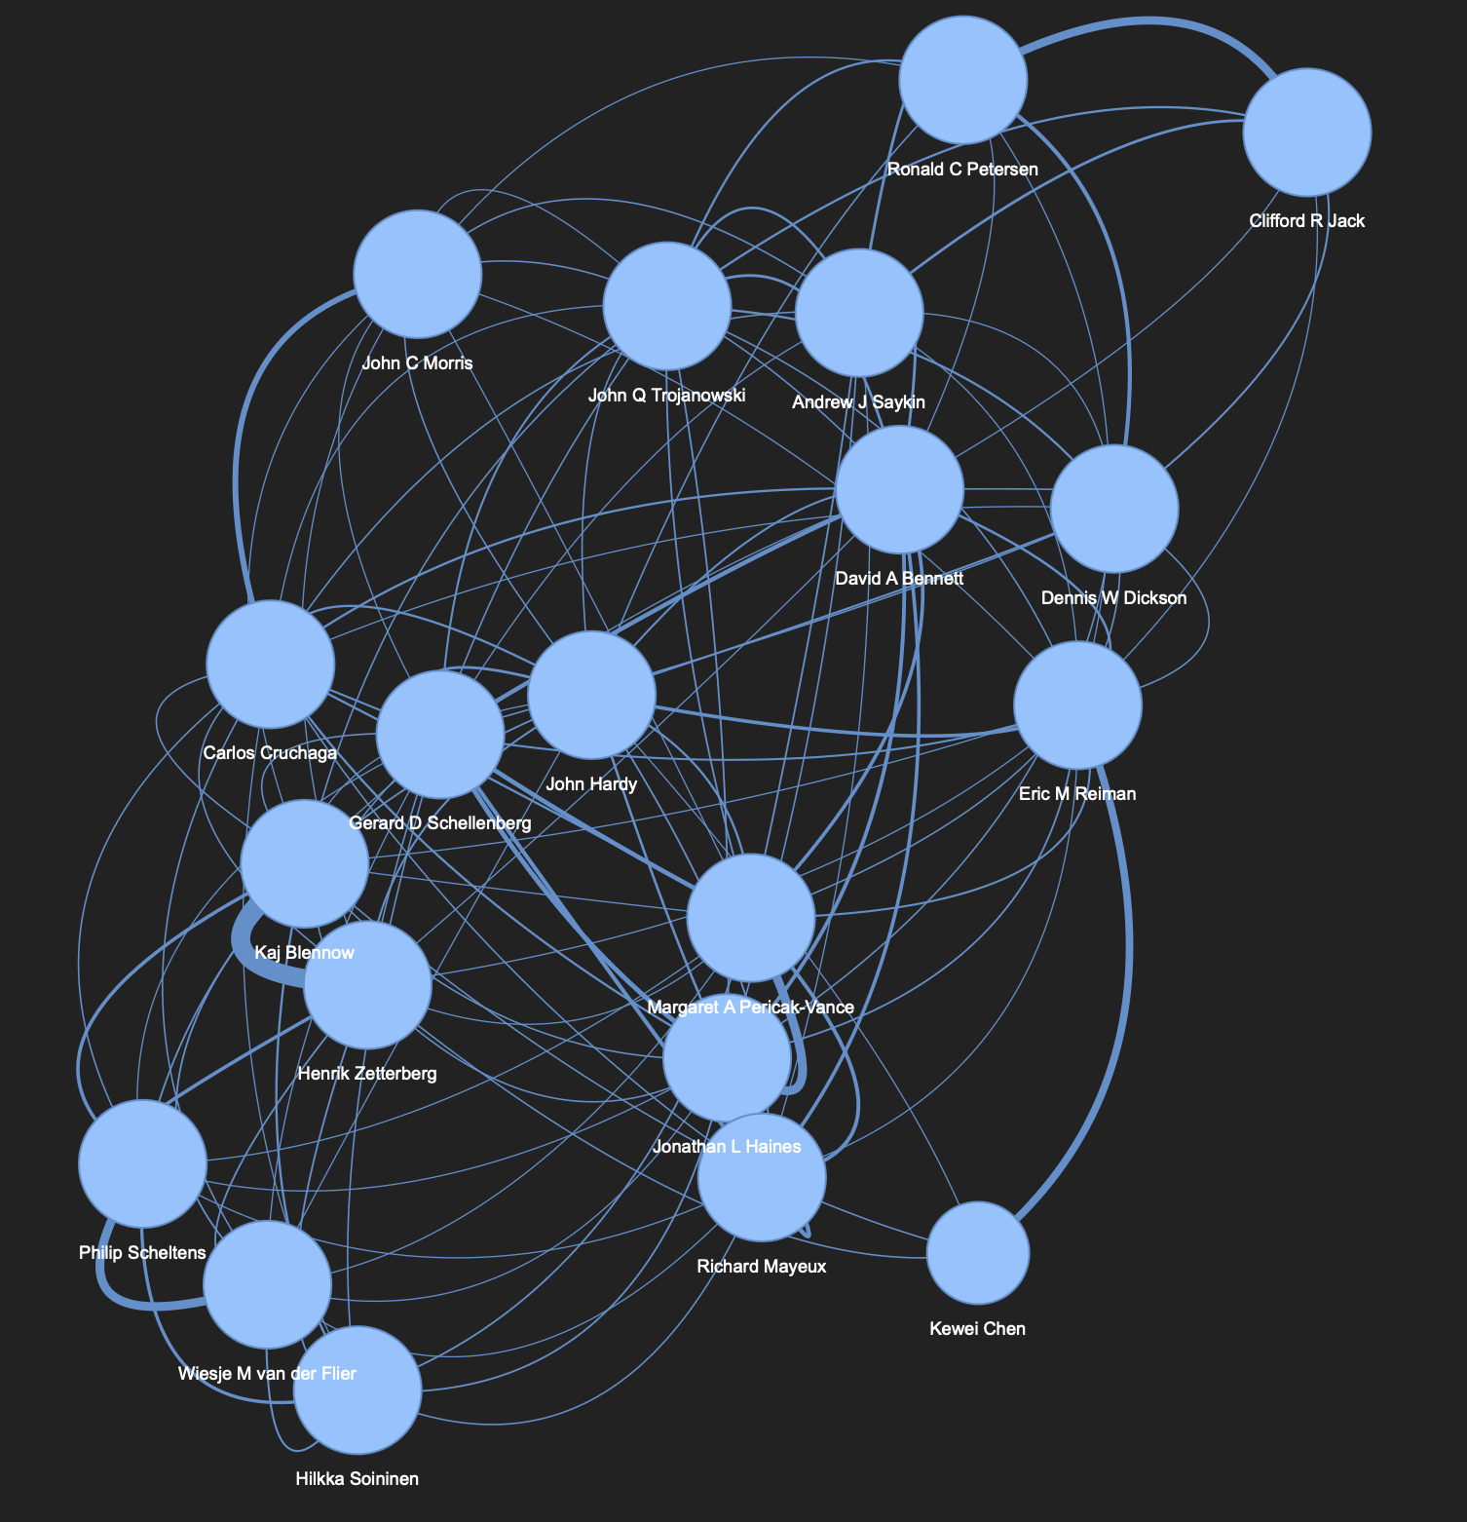
Collaboration Network: Top 20 Authors
Larger nodes indicate researchers with a higher number of collaborations
Nodes are mostly the same size
Edges are weighted to represent the amount of collaboration between any two researchers
2-3 communities in the network could suggest groups focusing on specific subfields of APOE research
HTML file available

Slide 7
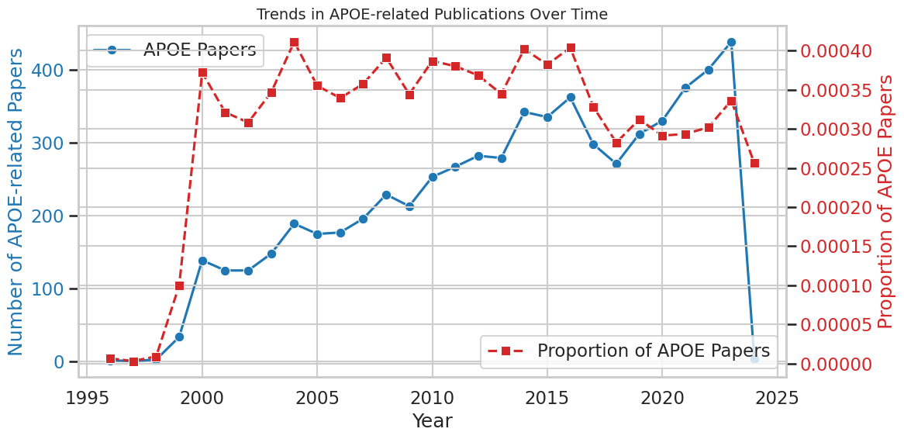
APOE Research Publication Trends
Rising Trends: APOE-related publications (blue line) increased steadily, peaking around 2020, before a sharp decline.
Stable Proportion: The proportion of APOE papers (red dashed line) rose until 2000, then remained relatively stable with minor fluctuations.
Recent Decline: Both total publications and their proportion show a decrease post-2020
Notes:
Introduction: This graph illustrates the trends in APOE-related publications over time, focusing on both the number of papers and their proportion among all publications.
Key Point 1: The total number of APOE-related papers (blue line) grew steadily from 1995, peaking around 2020, followed by a sharp decline.
Key Point 2: The proportion of APOE-related papers (red dashed line) increased significantly until 2000 and then stabilized, showing minor fluctuations.
Key Point 3: Post-2020, both the number of papers and their proportion show a noticeable decline, which may indicate reduced focus or shifting research priorities.
Closing: This data highlights the historical trends in APOE research and could suggest a need to investigate the reasons behind the recent decline.

Slide 8
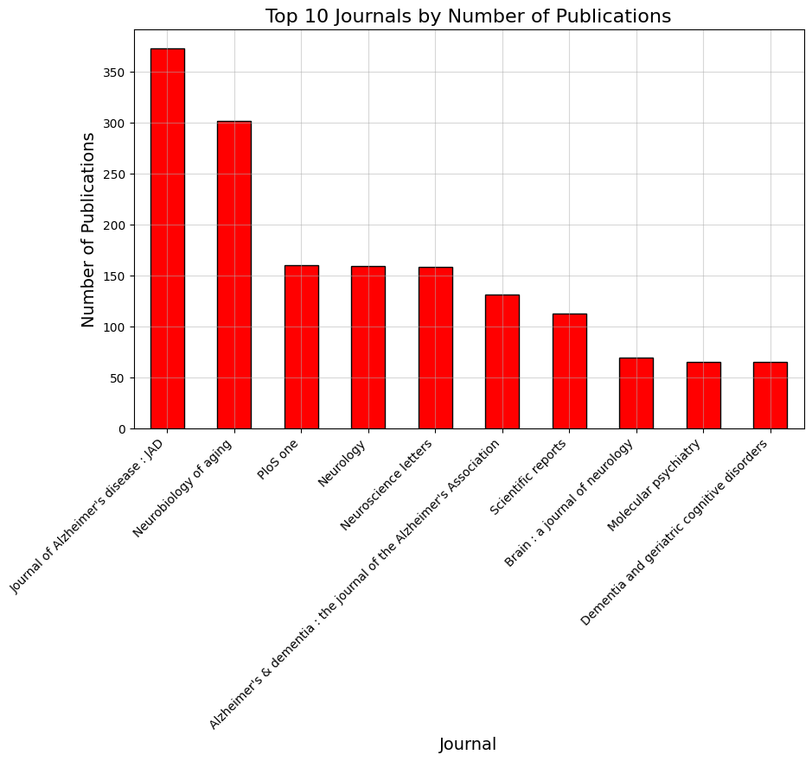
Impact factor of Journals
Top Journal: Journal of Alzheimer’s Disease (JAD) has the highest number of publications, exceeding 350.
Second Place: Neurobiology of Aging follows with around 300 publications.
Mid-Tier Journals: PLOS One, Neurology, and Neuroscience Letters have publication counts in the 150–200 range.
Scientific Reports: Publishes slightly fewer than the mid-tier journals, close to 150.
Lower Tier: Molecular Psychiatry and Dementia and Geriatric Cognitive Disorders are among the journals with the least publications, under 100.
Overall Trend: A steep decline in the number of publications from the top journal to the lowest.
Notes:
Impact Factor (IF) is a metric used to evaluate the average number of citations received per article published in a particular journal during a specific time frame (usually two years).
It serves as a proxy for the scientific reputation and significance of the journal within the academic community.
Research Concentration:
A significant portion of APOE-related studies are published in leading journals such as the Journal of Alzheimer's Disease and Neurobiology of Aging, underscoring their pivotal role in disseminating key findings in this domain.
Core Focus Areas:
Prominent journals emphasize research on neurodegenerative diseases, aging, and neurology, highlighting APOE's critical involvement in these fields.
Impactful Research Visibility:
High publication volumes in these journals establish them as central platforms for APOE research, ensuring widespread visibility and recognition within the scientific community.
Strategic Targets for Researchers:
For researchers aiming to maximize their impact in APOE studies, these journals represent strategic venues for publication, facilitating engagement with a focused and relevant audience.

Slide 9
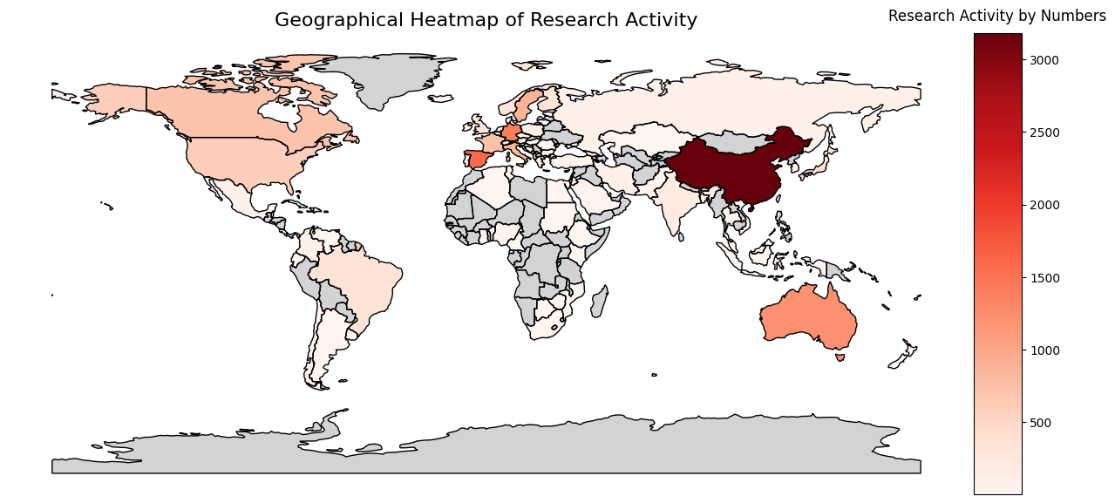
Research Activity Distribution
A heatmap is plotted, coloring each country based on its research activity.
Countries with higher research activity appear in warmer colors deep red and red, while those with lower activity are in cooler colors orange and white.
The heatmap provides a global view of where the research on APOE gene therapy,is concentrated.
Notes:
Introduction: This heatmap illustrates the geographical distribution of research activity, with darker shades indicating higher activity.
Key Observation 1: Research activity is predominantly concentrated in China, as shown by the darkest red region, followed by other key contributors like the United States, Australia, and select European countries such as Germany and Spain.
Key Observation 2: Most countries in Africa, South America, and parts of Asia exhibit significantly lower levels of research activity, represented by the lightest shades.
Key Observation 3: This visualization highlights the disparities in research contributions across the globe, with a few countries dominating the landscape.
Closing: Such insights can guide discussions on increasing research accessibility and addressing the global imbalance in academic contributions.

Slide 10
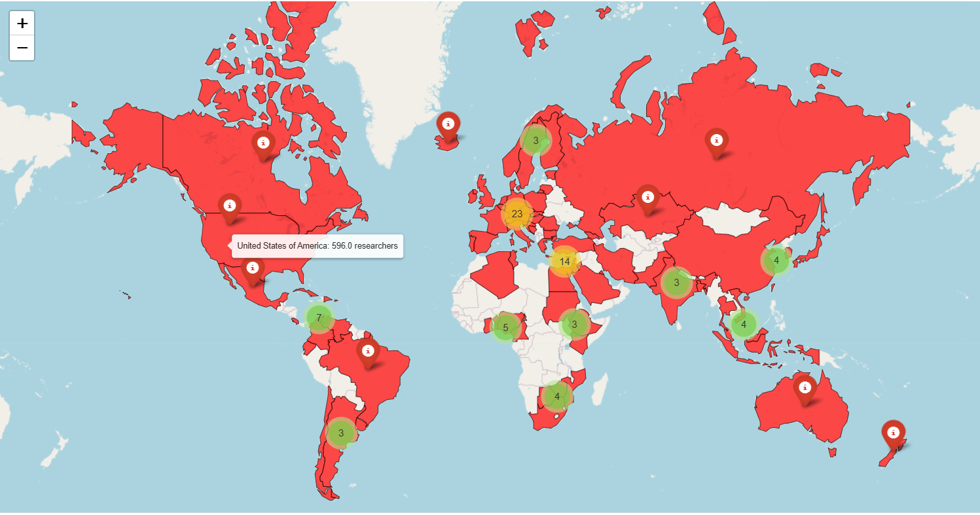
Research Activity Distribution - 2 (advanced)
The geographical distribution of researchers and their counts by country.
The map visualizes the number of researchers working on the APOE gene therapy (or the related field) from different countries.
Countries with more researchers are highlighted with a darker or more intense color (e.g., red), while countries with fewer researchers are lighter or absent (gray for "No Data").
Clicking on a country or marker may display detailed information such as the country's name and the number of researchers.
Notes:
Introduction: This map showcases the global distribution of researchers, with key regions highlighted based on the number of researchers.
Key Insights:
High Concentration Areas: The United States leads with 596 researchers, followed by other notable hubs such as Europe and specific countries in Asia and Oceania.
Clusters: Clusters of significant research activity are visualized with markers, indicating regions with a substantial research presence.
Underrepresented Regions: Many countries, particularly in Africa and parts of South America, show minimal or no research activity, as indicated by the absence of markers.
Conclusion: The map highlights the disparity in research distribution globally, emphasizing the dominance of certain countries while revealing gaps in others. And HTML file is also available.

Slide 11
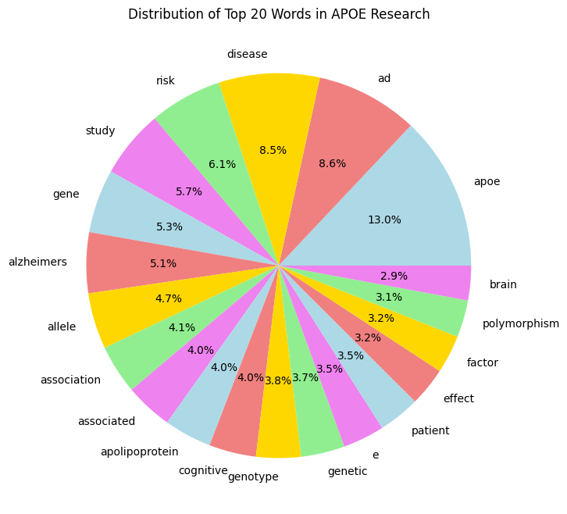
Distribution of Top 20 Words in APOE Research
Words like "APOE," "Alzheimer," "gene," and "study" are the most frequent, taking up large portions of the chart.
This highlights the key areas of focus in APOE research, showing the emphasis on Alzheimer's and genetic studies.
Words like "effect," "patient," and "factor" suggest researchers are not only studying genetics but also looking at clinical impacts of APOE.
Notes:
Words like "APOE," "Alzheimer," "gene," and "study" are the most frequent, taking up large portions of the chart. This highlights the key areas of focus in APOE research, showing the emphasis on Alzheimer's and genetic studies.

Slide 12
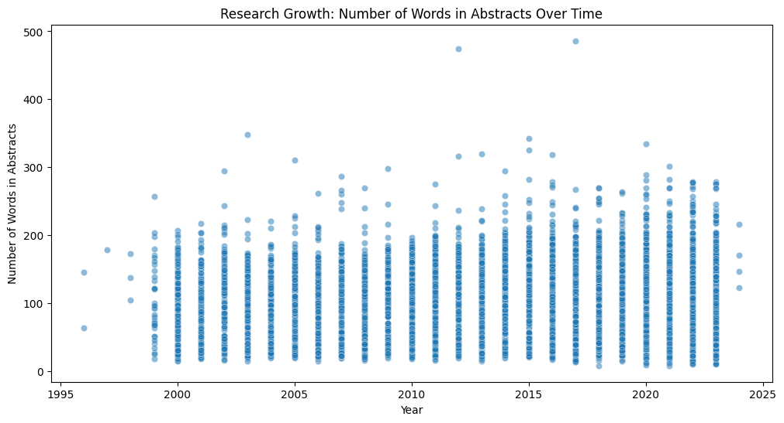
Research Growth Over Time
Increased Research: More dense points over time show growing interest in this field.
Peak Activity: The period from 2010 to 2020 shows the highest activity.
Overall Trend: Research has consistently expanded and diversified over the years.
Notes:
Each dot represents the total word count for a year. You can see an upward trend, meaning more research and publications in recent years. It highlights how the field has grown and gained momentum.

Slide 13
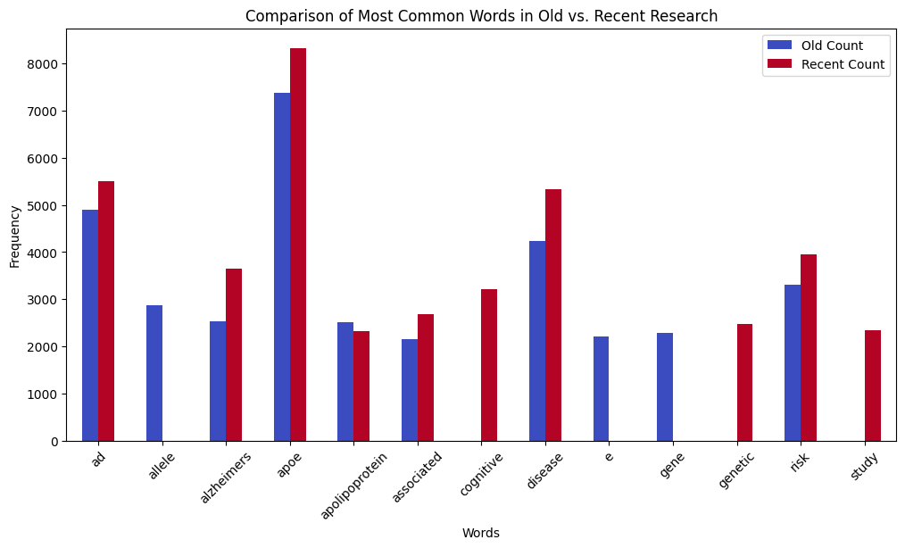
Comparison of Old vs. Recent Research
Recent focus on "genetics" reflects advancements in technology.
Declining use of terms like "lipids" suggests changing priorities.
Words like "Alzheimer" remain equally significant.
Early studies explored APOE’s structure and genetics; newer studies focus on its role in Alzheimer’s Disease and patient care.
Notes:
Some words, like "genetics," are more popular in recent research. Older research focused more on terms like "lipids." Words like "Alzheimer" remain important in both old and recent studies. It shows how research priorities and language have shifted over time.

Slide 14
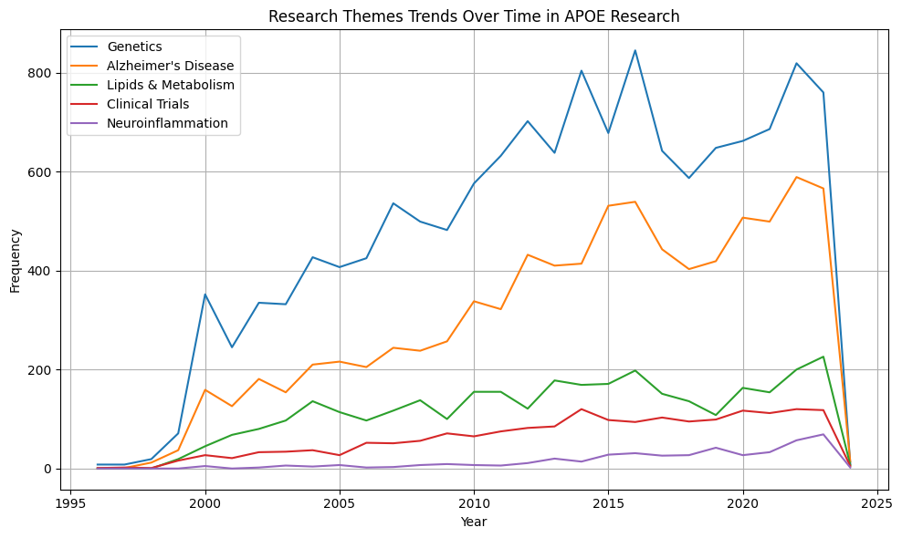
Trends in APOE Research Themes
Genetics - Consistently high
Alzheimer's Disease - Rising trend
Emerging Themes - Neuroinflammation is still in the clinical trial phase.
Early research focused on genetic mechanisms.
Modern research emphasizes disease impact, prevention, and therapies.
Notes:
"This graph shows how research themes have changed over time."
"Genetics and Alzheimer's Disease are key areas of focus."
"Neuroinflammation is a newer area, still being explored in clinical trials."

Slide 15
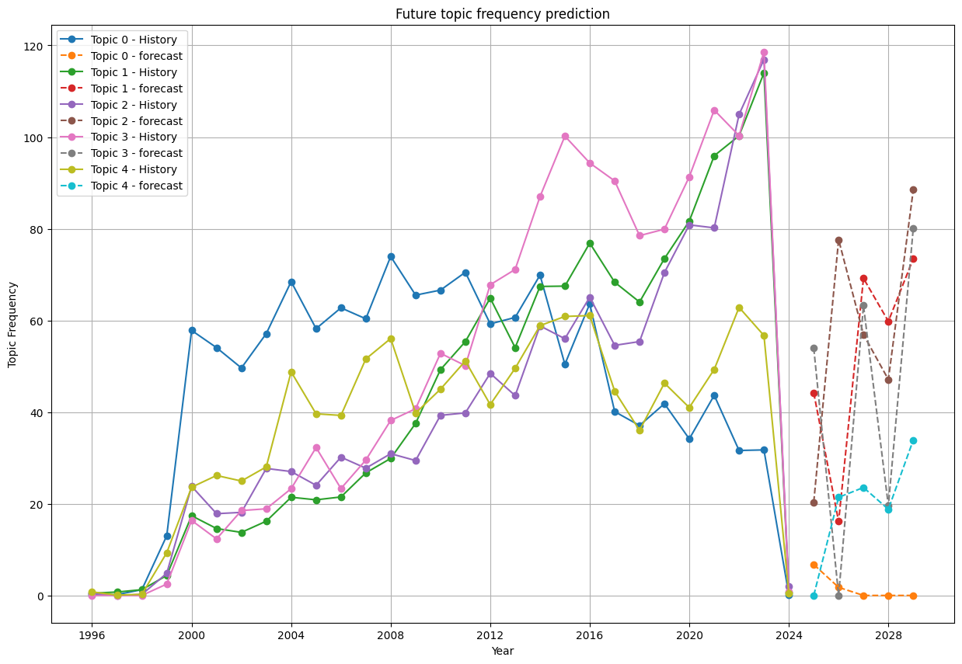
Future topic frequency prediction
Group 1：disease patients allele
Group 2：disease alzheimer risk
Group 3：mice disease apoe4
Group 4：cognitive ε4 carriers
Group 5：gene genes cholesterol
In the future, research on genes will decrease
Research on diseases will gradually increase
Notes:
After performing topic modeling and time prediction based on the title summary,
Except for the first group, all other groups will show an upward trend.
it can be seen that the second group of keywords is worth studying

Slide 16
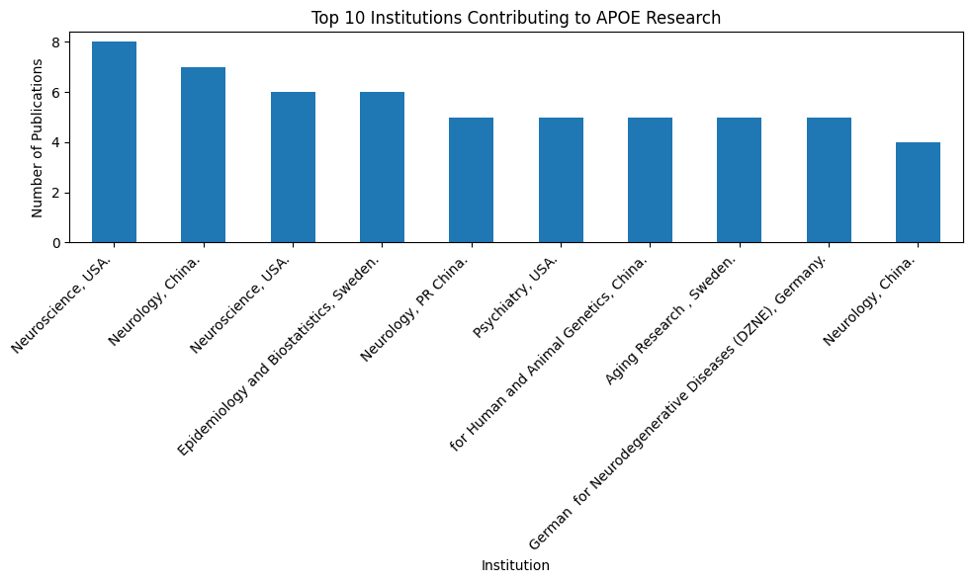
Top 10 Institutions Contributing to APOE Research
Ranking of Institutional Contribution to Research
Major institutions are from the United States, China, and Sweden
Notes:
This picture is读。We can select excellent institutions from the picture for cooperation

Slide 17
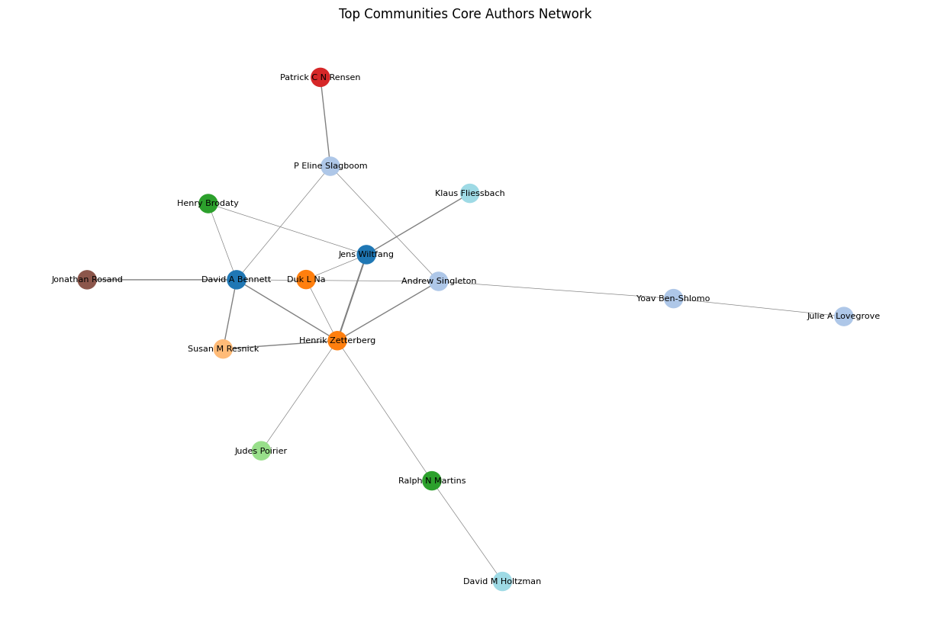
Top 16 Communities Core Authors Network
The dots represent the core authors
The thickness of the lines represent the the degree of collaboration.
Filter core authors based on the community
Filter out the core authors’ collaborations
Consider collaboration partners
Notes:
The dots represent the core authors of each community, and the thickness of the lines represent the degree of collaboration.
The previous images used different algorithms, but all of them found Henrik as the key author with the most collaborations.

Slide 18
Challenges
Missing Data : Some papers may lack key information (e.g., missing author names, incomplete abstracts, or missing publication years).
Inconsistent Formatting: Author names or journal names might be inconsistently recorded, making it difficult to identify authors accurately, group authors, or categorize papers.
Duplicate Records: Papers may be listed multiple times with slight variations in the metadata, which is skewing the results.
Large Dataset Processing: If the dataset contains many records, it can lead to memory and performance issues during computation and visualization.
Notes:
Introduction: During the analysis of APOE-related research, we encountered several challenges that required careful handling to ensure accurate results.
Point 1 - Missing Data:
Some papers lacked crucial details, such as author names, publication years, or complete abstracts, which limited our ability to perform comprehensive analyses.
Point 2 - Inconsistent Formatting:
Author and journal names were often recorded inconsistently, complicating tasks like grouping authors, identifying collaborations, or categorizing papers accurately.
Point 3 - Duplicate Records:
Duplicate entries with slight metadata variations led to skewed results and required significant effort to clean and deduplicate the data.
Point 4 - Large Dataset Processing:
The sheer volume of records created memory and performance challenges during computations and visualizations, requiring optimization strategies.
Conclusion: Despite these challenges, we implemented data cleaning, deduplication, and optimization techniques to minimize their impact and derive meaningful insights from the analysis.

Slide 19
Solutions
Missing Data
Impute missing values (e.g., averages, placeholders).
Cross-reference external databases (e.g., PubMed, CrossRef).
Filter out records missing critical information.
Inconsistent Formatting
Normalise text (lowercase, remove spaces).
Use fuzzy matching for variations in author/journal names.
Map common variations using dictionaries.
Duplicate Records
Identify exact duplicates using .duplicated().
Apply fuzzy matching for near-duplicates.
Consolidate records by merging metadata.
Large Dataset Processing
Use chunked processing (pandas or dask).
Optimize data types (e.g., float64 → float32).
Leverage cloud or distributed computing for scalability.
Best Practices
Automate cleaning workflows.
Maintain validation checks and detailed logs.
Sample data for faster insights.
Notes:
Introduction: To address the challenges encountered during the APOE-related research analysis, we implemented several solutions and best practices to ensure data quality and performance.
Point 1 - Missing Data:
For missing values, we imputed placeholders or averages where possible and cross-referenced external databases like PubMed for missing information.
Records missing critical data were filtered out to maintain the integrity of the analysis.
Point 2 - Inconsistent Formatting:
Text normalization, such as converting to lowercase and removing spaces, helped standardize author and journal names.
Fuzzy matching and dictionaries of common variations were used to align inconsistencies effectively.
Point 3 - Duplicate Records:
Exact duplicates were identified using .duplicated(), while fuzzy matching handled near-duplicates.
Metadata from similar records was consolidated to create accurate representations.
Point 4 - Large Dataset Processing:
We used chunked processing with Pandas or Dask and optimized data types (e.g., float64 to float32) to reduce memory usage.
Distributed computing and cloud resources were leveraged to process large datasets efficiently.
Point 5 - Best Practices:
Automated workflows were developed for consistent data cleaning.
Validation checks and detailed logs ensured transparency and traceability.
Sampling techniques provided quick insights and reduced the need for processing the entire dataset at once.
Conclusion: These solutions allowed us to overcome the challenges effectively and ensure a robust and reliable analysis.

Slide 20
Conclusions
Research Trends: APOE publications peaked in 2020 but declined sharply after, with stable proportions since 2005.
Geographical Insights: Research is dominated by the U.S., China, and Europe, with minimal contributions from other regions.
Focus Areas: Shifted from genetic mechanisms to clinical implications, especially Alzheimer’s and aging.
Gaps: Declining trends highlight opportunities for innovative research in underexplored areas.
Notes:
Introduction: This slide summarizes key findings from the analysis of APOE-related research based on publication trends, geographical contributions, and thematic shifts.
Point 1 - Research Trends:
Research on APOE grew steadily until peaking in 2020 but has seen a sharp decline since.
The proportion of APOE-related papers relative to all PubMed publications has remained stable since 2005, indicating consistent but limited growth.
Point 2 - Geographical Insights:
Research is predominantly concentrated in the U.S., China, and Europe, reflecting their leadership in this field.
Other regions, especially low- and middle-income countries, have contributed minimally, highlighting global research disparities.
Point 3 - Focus Areas:
Earlier research emphasized APOE’s genetic mechanisms, while more recent studies shifted to clinical applications, particularly Alzheimer’s and aging-related diseases.
Point 4 - Gaps:
The recent decline in publications suggests either saturated research areas or shifting priorities, offering opportunities for innovative studies in underexplored topics.
Conclusion: These findings emphasize the need for renewed focus, inclusive collaboration, and exploration of less-studied aspects of APOE to advance this critical field further.
✅ Identify Key Active Researchers – We will determine the most active researchers based on publication count and visualize them in a bar chart.
✅ Map Collaborations – A co-authorship network will help illustrate researcher connections and avoid engaging with competing groups.
✅ Analyze Research Trends – A timeline of APOE-related publications compared to overall PubMed trends will show how interest in this field has evolved.
✅ Provide Additional Insights – We are also identifying leading institutions, emerging researchers, and trending research topics, adding further value beyond their request.

